Slide 1

SENTIMENT ANALYSIS FOR MARKETING
01/11/2023
Done by
MEHANDHAN .GH ,HRIDAI JAIN.D,JAGADEESAN.M,GUNASEKAR .D

Slide 2
Abstract
Sentiment analysis for marketing
Sentiment analysis, or opinion mining, is a crucial natural language processing technique used to understand and extract valuable insights from product reviews. In the digital age, consumers rely heavily on online reviews for informed purchasing decisions. This paper provides an overview of sentiment analysis techniques, including data pre-processing , feature extraction, sentiment classification, and evaluation metrics. Existing sentiment analysis tools and frameworks help businesses gain insights into customer opinions, aiding decision-making and product improvements. Ethical considerations are also discussed, emphasizing privacy and responsible data usage.

Slide 3

Problem Statement
Sentiment analysis for marketing
With the proliferation of e-commerce platforms and social media, product reviews have become a fundamental part of the consumer decision-making process. Consumers regularly consult online reviews to gather information and gauge the quality, features, and performance of products before making a purchase. This has led to an explosion in the volume of user-generated content that can be analysed for sentiment.
The problem is to perform sentiment analysis on customer feedback to gain insights into competitor products. By understanding customer sentiments, companies can identify strengths and weaknesses in competing products, thereby improving their own offerings. This project requires utilizing various NLP methods to extract valuable insights from customer feedback.

Slide 4

Dataset
Sentiment analysis for marketing
One of the most important problems in e-commerce is the correct calculation of the points given to after-sales products. The solution to this problem is to provide greater customer satisfaction for the e-commerce site, product prominence for sellers, and a seamless shopping experience for buyers. Another problem is the correct ordering of the comments given to the products. The prominence of misleading comments will cause both financial losses and customer losses. In solving these 2 basic problems, e-commerce site and sellers will increase their sales, while customers will complete their purchasing journey without any problems . This dataset consists of ranking product ratings and reviews on Amazon
Amazon Product Reviews: Amazon provides a vast collection of product reviews across a wide range of product categories. You can access these reviews through the Amazon Product Advertising API or by web scraping. Amazon reviews are commonly used for sentiment analysis due to their diversity and quantity.

Slide 5

Feature Extraction
Sentiment analysis for marketing
Bag of Words (BoW):
Create a vocabulary of all unique words in the corpus of reviews.
Represent each review as a vector where each element corresponds to the frequency of a word in the vocabulary within that review.
This approach is simple but doesn't consider word order or context.
Word Embeddings (Word2Vec, GloVe, FastText):
Use pre-trained word embeddings to represent words as dense vectors.
Combine word vectors in a review to get a document-level vector (e.g., by averaging, summing, or using a more complex model like Doc2Vec).
Word embeddings capture semantic meaning and word relationships.
Emoticons and Emoji Analysis:
Consider emoticons and emojis in the text, as they often convey sentiment.
Assign sentiment scores to these symbols and incorporate them into the analysis.
Syntax and Grammar Features:
Explore syntactic features like sentence length, punctuation usage, and grammatical structure.
These features can sometimes be indicative of sentiment or writing style.

Slide 6
Proposed Method
Sentiment analysis for marketing
CNN, which has been used on a large number of image datasets, works by moving the "convolutional" filter—that is, the kernel—through the image to extract its most important properties. The CNN function may also be applied in the text if the input data were provided as one-dimensional. Important features are retrieved, and local textual information is kept in the text area while the filter is moving. CNN is therefore a useful tool for text classification. An embedding layer, two convolutional layers, a pooling layer, and a fully connected layer made up the network. To make the sentence vectors a fixed size, we padded them. In other words, too long sentences were trimmed to a certain length, and the [PAD] token was appended to too short sentences.
CNN uses the so-called convolutional filtering techniques, which automatically learn features appropriate for the given job, in one of the existing experiments using deep learning to classify texts. It has been demonstrated that a single convolutional layer or a combination of convolutional filters may achieve comparable performance even without any special hyper parameter adjustment. For instance, if we use CNN for sentiment classification, the convolutional filters may capture the inherent syntactic and semantic features of sentimental expressions. Additionally, linguistic structure expertise in a target language is not required by CNN. These benefits have allowed the CNN to be effectively used for a number of text studies, including sentence modelling, semantic parsing, and query-based search. Because it maintains the word sequence's order, one may contend that the Recurrent Neural Network (RNN) performs better for text categorization than the CNN. On the other hand, the CNN may also recognize sequential patterns; for instance, machine translation has effectively used convolutional filters in conjunction with the attention strategy. Additionally, the CNN is trainable with a limited amount of data because it often has fewer parameters than the RNN. CNN is renowned for delving into the depths of pertained word embeddings. In this research, we develop a CNN model for sentiment categorization and provide experimental findings demonstrating the superiority of our network over other deep learning models

Slide 7
Code [ Import Library]
Sentiment analysis for marketing
import pandas as pd
import matplotlib.pyplot as plt
import seaborn as sns
import numpy as np
df = df.drop(columns=['Unnamed: 0'])
df.head()
df.rename(columns={
'overall': 'userScore'
}, inplace=True)
df.head()
col = ['reviewText', 'userScore']
df = df[col]
df.head()
fig, ax = plt.subplots(nrows=1, ncols=2, figsize=(12,5))
sns.histplot(data=df, x='userScore', ax=ax[0]).set_title('histogram plot')
sns.kdeplot(data=df, x='userScore', ax=ax[1]).set_title('KDE plot')
plt.tight_layout()
plt.show()

Slide 8
Code[EDA]
Sentiment analysis for marketing
df_sent = df.copy()
import nltk
test = df_sent['reviewText'][5]
token_test = nltk.word_tokenize(test)
test_pos_tag = nltk.pos_tag(token_test[:5])
test_pos_tag
from nltk.sentiment import SentimentIntensityAnalyzer
sarcasm_text = 'yeah, way to wear a raincoat genius'
sia = SentimentIntensityAnalyzer()
sia.polarity_scores(sarcasm_text)
from transformers import AutoTokenizer
from transformers import AutoModelForSequenceClassification
from scipy.special import softmax
MODEL = f"cardiffnlp/twitter-roberta-base-sentiment"
tokenizer = AutoTokenizer.from_pretrained(MODEL)
model = AutoModelForSequenceClassification.from_pretrained(MODEL)
encoded_text = tokenizer(sarcasm_text, return_tensors='pt') # a structure that algoritm will understand
encoded_text
output = model(**encoded_text)
output roberta_sarcasm = {
'roberta_pos': softmax(scores)[0],
'roberta_neu': softmax(scores)[1],
'roberta_neg': softmax(scores)[2],}
roberta_sarcasm

Slide 9
Code[ Test on Sarcasm]
Title of your presentation.
def roberta_score(review):
encoded_text = tokenizer(review, return_tensors='pt')
output = model(**encoded_text)
scores = output[0][0].detach().numpy()
scores = softmax(scores)
scores_dict = {
'roberta_neg': scores[0],
'roberta_neu': scores[1],
'roberta_pos': scores[2],
}
return scores_dict
res = {}
for i, row in df.iterrows():
try:
text = row['reviewText']
my_id = row['id']
roberta_score_result = roberta_score(text)
score_ = {**roberta_score_result}
res[my_id] = score_
except RuntimeError:
print(f'comment is too long for Roberta to handle for id {my_id}')
df_roberta = pd.DataFrame(res).T
df_roberta
df_roberta.reset_index(inplace=True)
df_roberta

Slide 10
Code[ Validate Sentimental Score]
Sentiment analysis for marketing
df_sent = pd.merge(df, df_roberta, how='inner', left_on='id', right_on='index')
df_sent
df_sent.sort_values(by='roberta_pos', ascending=False).values[0]
df_sent.sort_values(by='userScore', ascending=True).values[0]
df_sent.sort_values(by='roberta_neg', ascending=False).values[0]
fig, ax = plt.subplots(nrows=1, ncols=3, figsize=(12,5))
df_amazon_neg = df_sent.query('userScore < 3.0')
df_amazon_neu = df_sent.query('userScore == 3.0')
df_amazon_pos = df_sent.query('userScore > 3.0')
print(f'amazon negative review is {df_amazon_neg.shape[0]}')
print(f'amazon neutral review is {df_amazon_neu.shape[0]}')
print(f'amazon positive review is {df_amazon_pos.shape[0]}')
amazon negative review is 318
amazon neutral review is 141
amazon positive review is 4437
fig, ax = plt.subplots(nrows=1, ncols=3, figsize=(12,7))
sns.kdeplot(data=df_amazon_neg, x='roberta_pos', ax=ax[0], label='pos').set_title('Amazon Negative Review')
sns.kdeplot(data=df_amazon_neg, x='roberta_neu', ax=ax[0], label='neu').set_title('Amazon Negative Review')
sns.kdeplot(data=df_amazon_neg, x='roberta_neg', ax=ax[0], label='neg').set_title('Amazon Negative Review')
sns.kdeplot(data=df_amazon_neu, x='roberta_pos', ax=ax[1], label='pos').set_title('Amazon Neutral Review')
sns.kdeplot(data=df_amazon_neu, x='roberta_neu', ax=ax[1], label='neu').set_title('Amazon Neutral Review')
sns.kdeplot(data=df_amazon_neu, x='roberta_neg', ax=ax[1], label='neg').set_title('Amazon Neutral Review')
sns.kdeplot(data=df_amazon_pos, x='roberta_pos', ax=ax[2], label='pos').set_title('Amazon Positive Review')
sns.kdeplot(data=df_amazon_pos, x='roberta_neu', ax=ax[2], label='neu').set_title('Amazon Positive Review')
sns.kdeplot(data=df_amazon_pos, x='roberta_neg', ax=ax[2], label='neg').set_title('Amazon Positive Review')

Slide 11
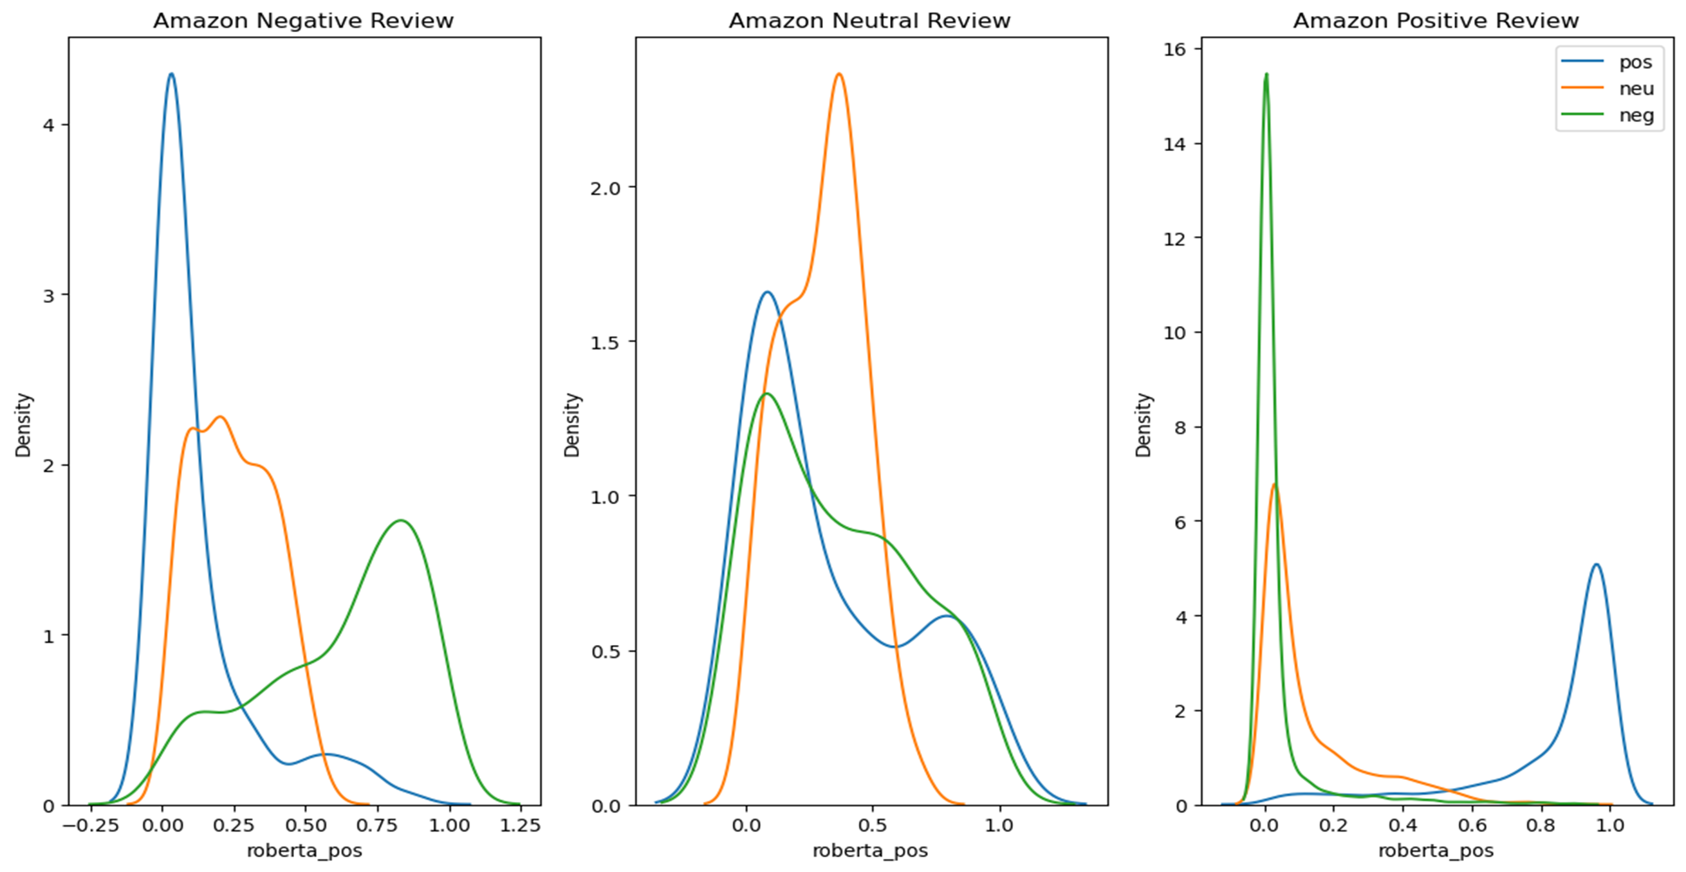
Code & Output
Sentiment analysis for marketing
plt.tight_layout()
plt.legend()
plt.show()
fig, ax = plt.subplots(nrows=1, ncols=3, figsize=(12,7))
sns.histplot(data=df_amazon_neg, x='roberta_neg', ax=ax[0])
sns.histplot(data=df_amazon_neg, x='roberta_neu', ax=ax[1])
sns.histplot(data=df_amazon_neg, x='roberta_pos', ax=ax[2])
plt.show()

Slide 12

Conclusion
Sentiment analysis for marketing
Importance of Sentiment Analysis: Sentiment analysis helps businesses understand the sentiment expressed in customer reviews, allowing them to make data-driven decisions, improve products and services, and enhance customer satisfaction.
Feature Extraction: Effective sentiment analysis relies on feature extraction techniques that transform raw text data into numerical or symbolic representations suitable for machine learning models. Common techniques include Bag of Words (BoW), TF-IDF, word embeddings, and more.
Challenges: Sentiment analysis faces challenges like sarcasm, irony, context-dependent sentiment, and the need to consider the overall context of a review, not just individual words
Model Selection: Various machine learning algorithms, such as Naïve Bayes, Support Vector Machines (SVM), and deep learning models like recurrent neural networks (RNNs) or convolutional neural networks (CNNs), can be used for sentiment analysis. Model selection should be based on the specific task and dataset.
Aspect-Based Analysis: In some cases, it's important to perform aspect-based sentiment analysis to understand which specific aspects of a product are receiving positive or negative feedback.

Slide 13

THANK YOU!
Sentiment analysis for marketing
THANK YOU!

